Slide 1










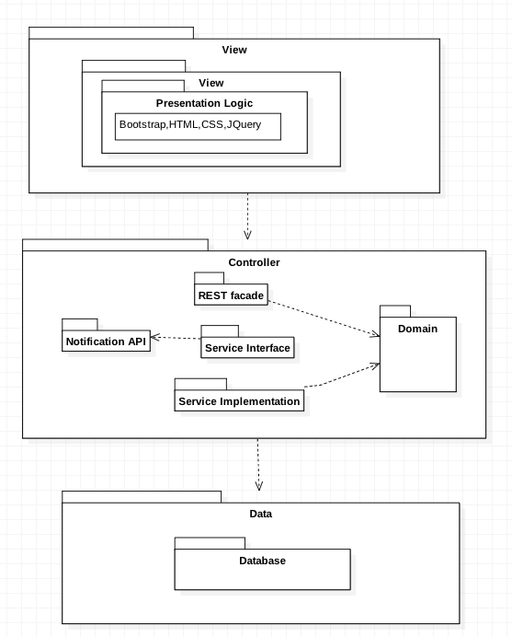
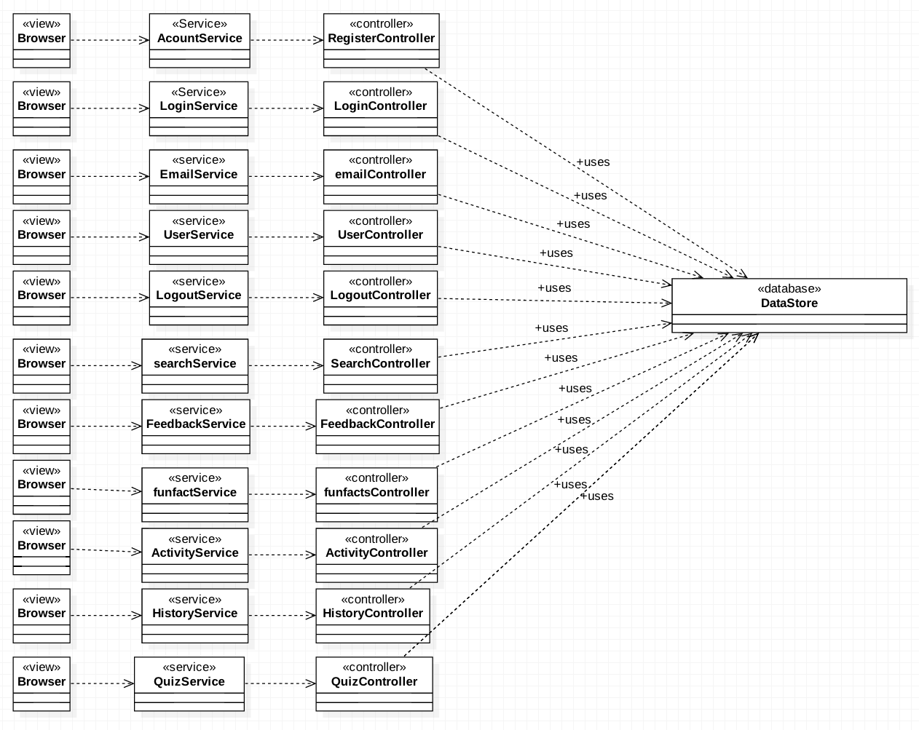
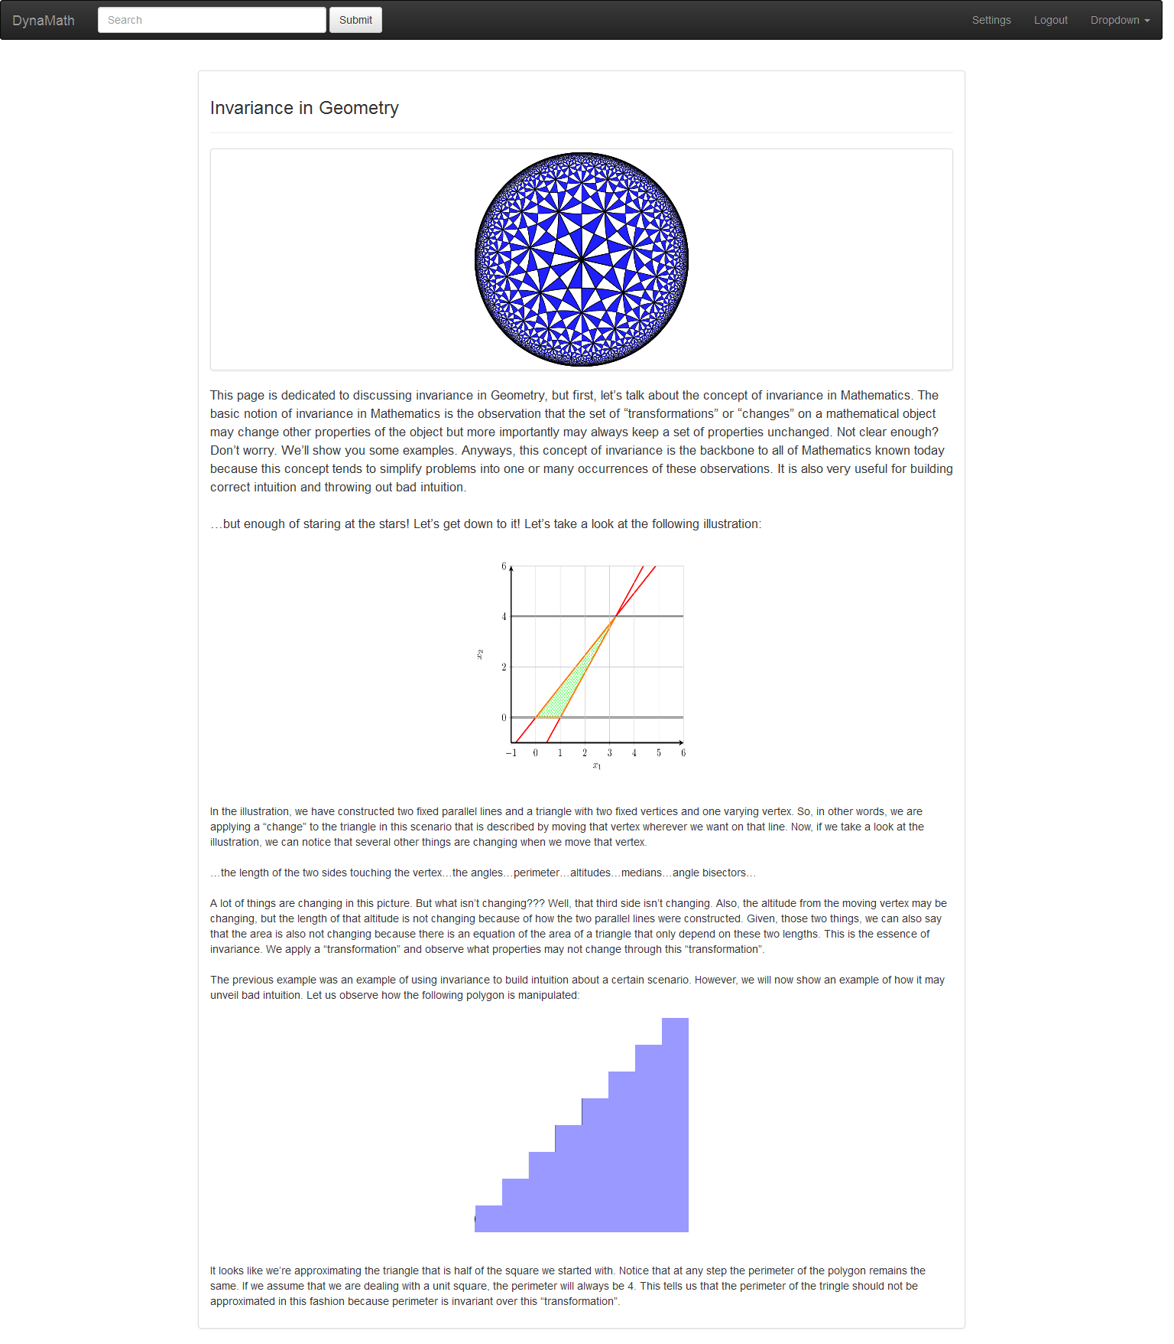
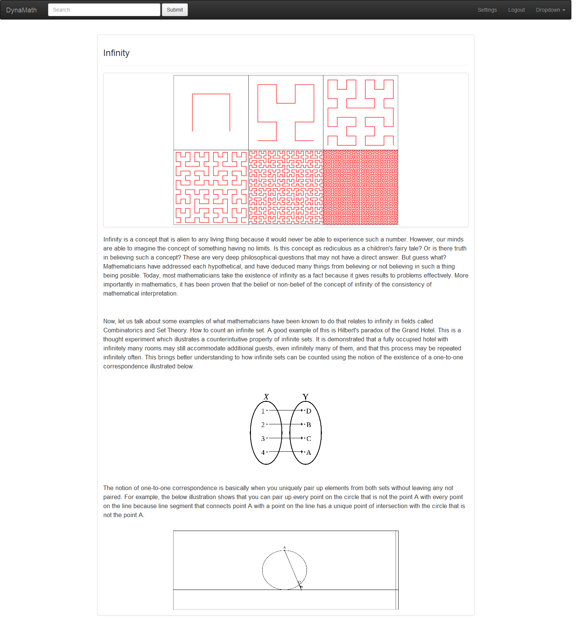
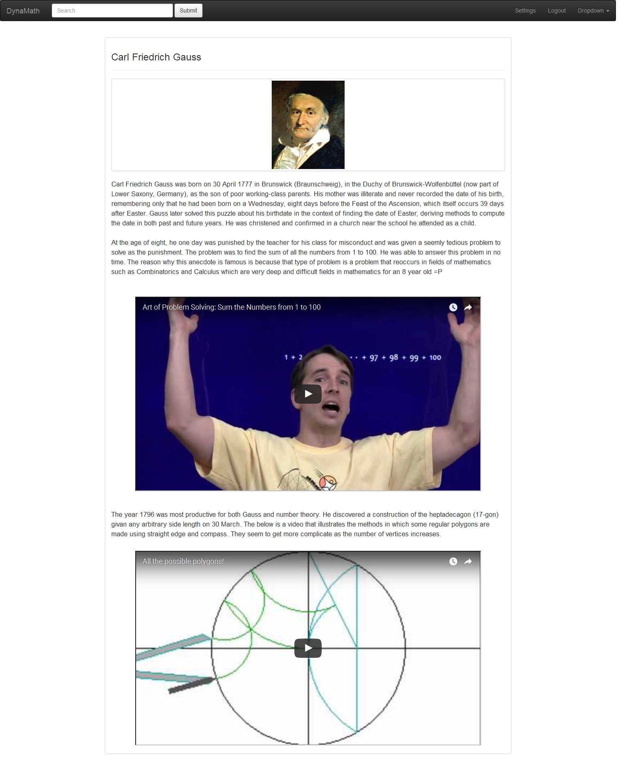
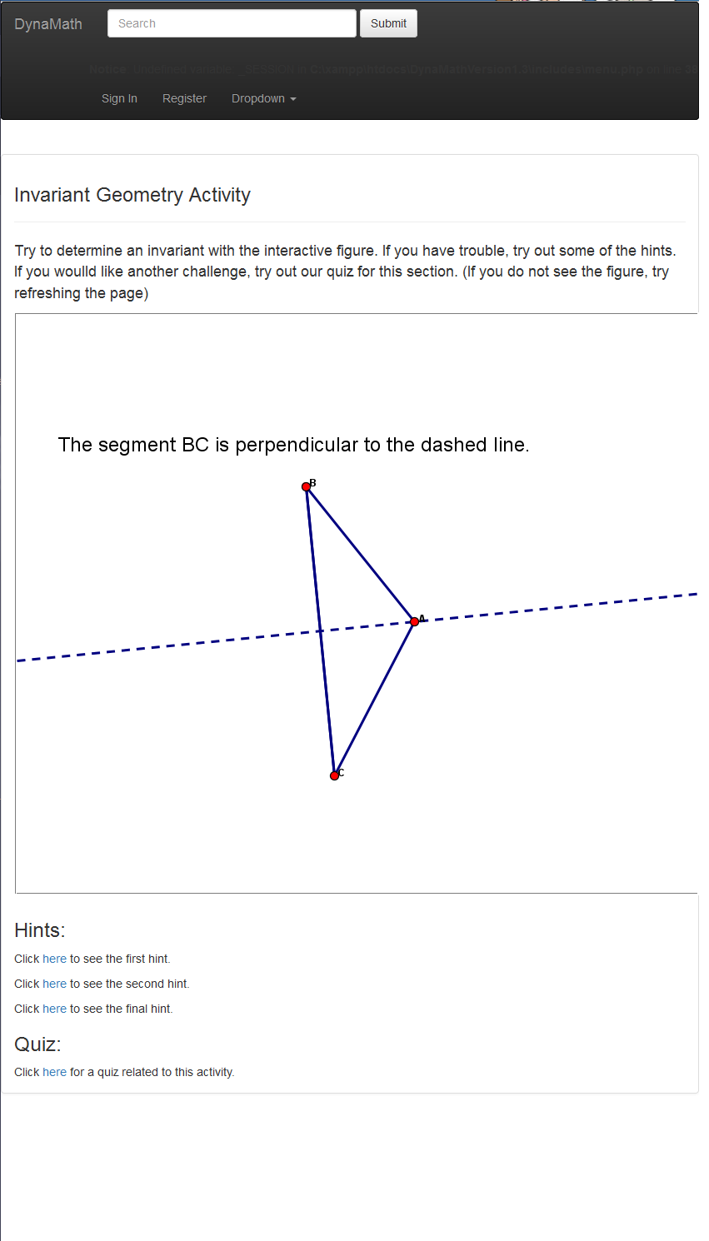
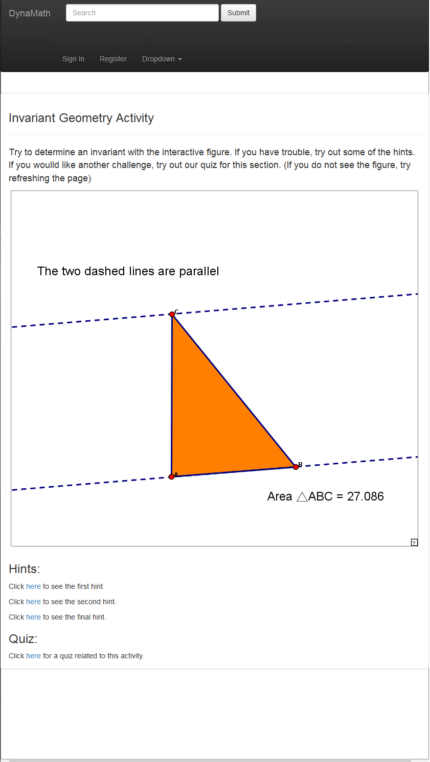
School of Computing & Information Sciences
Senior Project, 2015, Fall
Dynamic Mathematics Principles
Student: Andres Cubas, Florida International University
Mentor: Mario Eraso, Florida International University
Instructor: Masoud Sadjadi, Florida International University
Problem
Current System
System Design
The discipline of mathematics presents many challenges to different learners. A lack of sufficient mathematical skill and understanding affects one’s ability to make critically important educational, life, and career decisions. Our goal is to create a website were users can interact with our system to learn mathematical concepts dynamically, and also providing them with knowledge; giving them the chance to discover their new interests for mathematics.
There is no current system that provides this kind of functionality in FIU to the public. Currently the teaching methods used are typically passive abstract learning for enrolled college students. The limitations of this learning process are the lack of active engagement and as a consequence students move on without full understanding of the subject, closing their doors to great opportunities out there. This website will be created to increase the user opportunity of understanding mathematical knowledge. There are no previous versions of this system. This project will be initial code base of the system.
Object Design
Implementation
Requirements
Object Design
Sublime was development IDE used for
implementing the system.
The User Interface was done using CSS,BOOTSTRAP,HTML5. While the controller was done using PHP. Mysqli was also used for data storage through HTTP the system accesses. The Dynamic Activities were made with the JavaSketchpad framework.
The system shall…
Allow user to register an account .
Allow user to login.
Allow user to logout from the system.
Allow user to modify account
Allow user to delete account
Allow user to send feedback.
Allow user to rate activities.
Allow user to view About Us page.
Allow user to interact with history page.
Allow users to interact with Fun-Facts page.
Allow users to interact with Activity page.
Allow users to take quizzes and surveys
Allow users to view hints related to the activities.
.
Summary
The purpose of this project is to change people’s perspective towards mathematics. The website provides interactive activities, fun-facts, and history pages to enhance the learning experience. It also includes other features such as an about us page, feedback page, rate activity, quizzes, and surveys. In other words, this website is for educational purposes.
The Dynamic Mathematics Principles verification was done using Automated Testing (Selenium for automating UI testing), System Testing and Manual Testing. The objective of our System Tests were to make sure that the system was behaving appropriately.
Verification
Screenshots
Invariant Geometry
Infinity
Carl Friedrich Gauss
Dynamic Activity #1
Dynamic Activity #2
Acknowledgement
The material presented in this poster is based upon the work supported by Professor Mario Eraso and Masoud Sadjadi. Special thanks to my team Ingrid Troche, Mario Eraso, and Masoud Sadjadi

